Slide 1
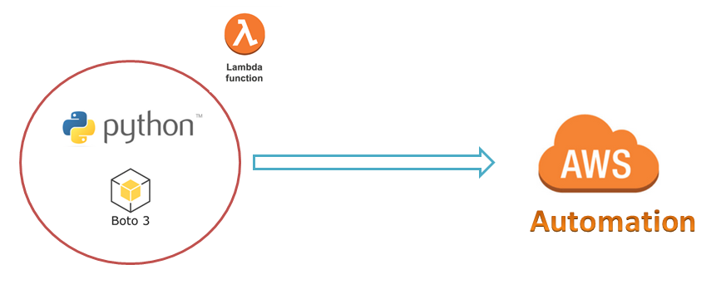
AWS Automation
with
boto3 of Python and Lambda Functions
Boto3 Waiters Concept
Loop control statements or commands
(break and continue)
Learn how to automate AWS common tasks using boto3 and Lambda

Slide 2

Boto3 Concepts:
The core concepts of boto3 are:
Session
Resource
Client
Meta
Collections
Waiters
Paginators
Loop control statements or commands
(break and continue)
Learn how to automate AWS common tasks using boto3 and Lambda

Slide 3
Boto3 waiter:
A way to block until a certain state has been reached.
Waiters are available for both resource and client but client waiters good to use in real time.
Loop control statements or commands
(break and continue)
Learn how to automate AWS common tasks using boto3 and Lambda

Slide 4
Thank you

